Slide 1
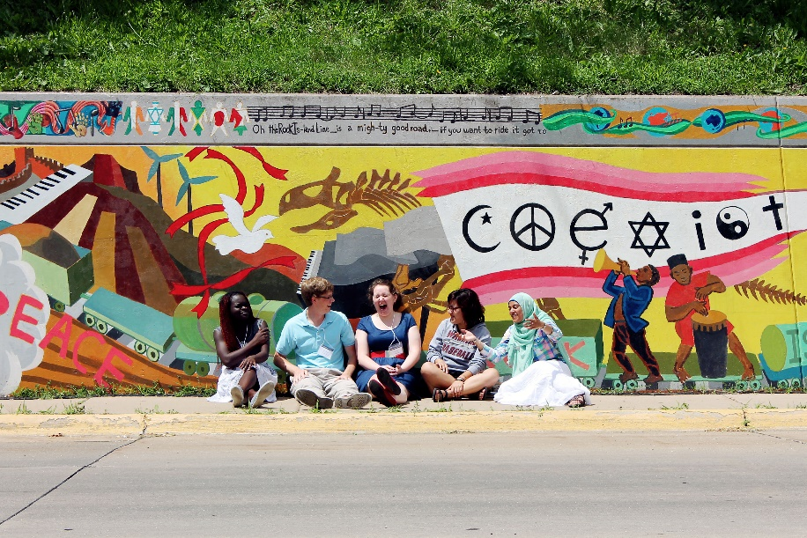
Engaging Others, Knowing Ourselves: A Lutheran Calling in a Multi-Religious World

Slide 2
Workshop Goals
To provide an invitation to an ELCA-wide conversation about our inter-religious calling and commitments.
To provide an overview of the content of each chapter.
To provide entry-points for discussion.
To provide additional resources for study, dialogue, and engagement.

Slide 3
An Invitation
This book invites us all into conversation by challenging us to reflect on our past, learn from our present, and envision the future to which God is calling us. The heart of the book is the real-life case studies of inter-religious relations unfolding in a variety of ELCA ministry contexts. They encourage us to understand that our questions, doubts, and failures are as important as our answers, convictions, and successes. They challenge us to embrace that while there are a variety of responses to religious plurality, our common response is rooted in our Lutheran vocation – our response to God’s love in Jesus Christ.
Presiding Bishop Elizabeth A. Eaton, p. 6, Foreword

Slide 4
INTRODUCTION TIME-TESTED QUESTIONS
Photograph by Sarah Bromberger, Augustana College (Rock Island) class of 2016, of participants at the first Interfaith Understanding Conference, June 1-3, 2014. The mural, entitled Cadence of Diversity, was painted by more than 50 Augustana students in 2009-2010, led by art professor Peter Xiao, cover art.

Slide 5
Introduction Overview
The ELCA has a long history of inter-religious relations, especially:
Lutheran-Jewish Relations
Lutheran-Muslim Relations
Inter-religious dialogue and engagement in a multi-religious world can be understood as part of our vocational life.
There are already numerous examples of how the ELCA is participating in this work, which can provide key insights and learnings.

Slide 6
Introduction Overview
There are many reasons we should practice inter-religious dialogue and cooperation, including:
Our calling to serve our neighbor demands that we know our neighbor.
Our calling to defend our neighbor demands that we know our neighbor.
God is at work in the challenge of inter-religious relations.
Christians are called to be peacemakers.
Christian self-understanding is deepened and enhanced through engagement with others.
We are called to be good citizens, to serve the common good.

Slide 7
Discussion Questions: Introduction
Regarding persons of another religion, this book seeks to ground our approach in the doctrine of vocation (that is, our calling to serve the neighbor and the community). Is this helpful? What are the implications for your life?

Slide 8
Discussion Questions: Introduction
The introduction says that believers do not need to know what God’s attitude is toward another religion in order to treat its adherents with generosity and to witness to the generosity of God. Do you agree with this approach? Why or why not?

Slide 9
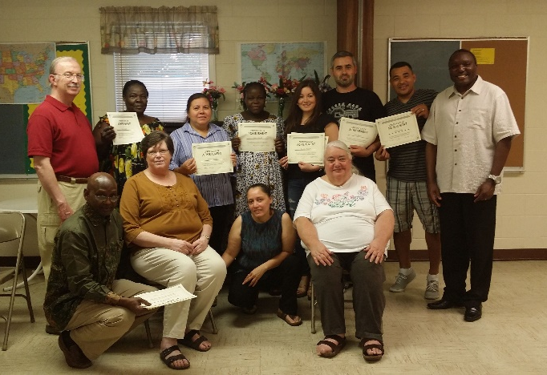
Discussion Questions: Introduction
Spring 2015 ESL students at classes sponsored by Salem Lutheran Church in Indianapolis hold up their certificates as they wrap up before the summer break (Photographer Devoe Slisher)
If shalom is all about relationships, and if God’s goal is to foster shalom all around, how does this affect our understanding of the Christian faith and Christian discipleship?
Spring 2015 ESL students at classes sponsored by Salem Lutheran Church in Indianapolis hold up their certificates (Photographer Devoe Slisher)

Slide 10
Discussion Questions: Introduction
What role does religion play in peacemaking? How can our own religion be an agent of peacemaking rather than an agent of conflict?

Slide 11
CHAPTER ONE New Realities, New Thinking Since 1990

Slide 12
Chapter One Overview
Religious diversity has long existed in North America, but it is presenting new challenges as inter-religious encounters become increasingly common.
Discipleship in a religiously plural world demands theological reflection.

Slide 13
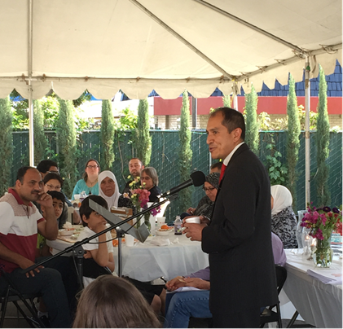
Chapter One Overview
Four ancient Christian practices provide guidance:
Speak the truth
Attend to the outsider
Pursue hospitality
Seek deepened faith through pilgrimage
Claremont, California Mayor Cory Calaycay shares the importance of the annual Interfaith Seder Experience for building peace.

Slide 14
Discussion Questions: Chapter One
Look around your community/neighborhood. What religious groups are represented there? What places of worship do you find? Has the religious map of your community/neighborhood changed in the past years?
See www.pluralism.org/directory

Slide 15
Discussion Questions: Chapter One
Does your congregation, or individuals within it, have any relationships with these groups or their members? Share, if you are willing, about a friendship that you have with someone whose faith is different from your own. Has that friendship made a difference in how you understand your friend’s religion and community?

Slide 16
Discussion Questions: Chapter One
Discuss the biblical “outsider” stories mentioned in the chapter. Can you think of others? Can you give examples from your own experience of times when it has been the “outsider” (to the familiar Christian community) who has brought “blessing, hospitality, practical help, or . . . a true word of rebuke”?

Slide 17
Discussion Questions: Chapter One
What does hospitality mean to you? Can you share a story about providing hospitality to others -- even when that seemed hard? Or can you relate a story about receiving hospitality from others, in ways that moved you? Thinking about some of the religious groups in your own community/ neighborhood, what might inter-religious hospitality look like?

Slide 18
Discussion Questions: Chapter One
Have you ever participated in something you would call a “pilgrimage”? What was it like? What personal investment did you put into it? Were you changed by it? Does the notion of pilgrimage “to one another as to a holy site” make any sense to you? In your community, what might that look like?

Slide 19
CHAPTER TWO Guidelines for Interacting in the Real World

Slide 20
Chapter Two Overview
ELCA examples of inter-religious interaction are explored through three constructive models:
Sharing Spiritual Life, including communal worship, fellowship, ministry, and inter-religious families
Sharing The Life of the Mind, including dialogue, shared scripture study, and joint resource production
Sharing Practical Life and Service to the World, including dealing together with social issues; sharing physical space and resources; collaborative social action, advocacy, and service to the world; and non-congregational settings for interaction

Slide 21
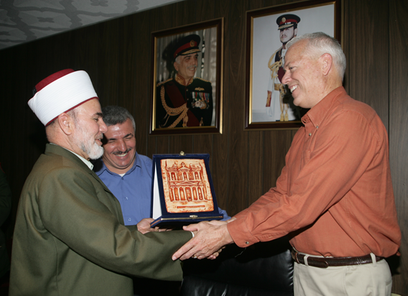
Chapter Two Overview
When planning inter-religious initiatives, consideration should be given to:
What have we learned?
What should we be careful about?
What might we try?
What should we be prepared for?
Gift giving after an inter-religious chaplaincy visit. Here the Mufti presents a gift showing Petra, a site visited during this trip to Chaplain (Colonel) Adams-Thompson with Chaplain (Major) Abdullah Hulwe translating in the background. In 2015 Abdullah was one of only six Muslim Imams in the United States Army.

Slide 22
Discussion Questions: Chapter Two Sharing Spiritual Life
Choose one or two of the case studies demonstrating shared worship (such as the Jewish-Lutheran Thanksgiving service in Santa Monica) and discuss:
What surprised you about this story?
What troubled you, or prompted further questions?
What are some ways you might follow their example to create an interfaith worship experience in your own setting?

Slide 23
Discussion Questions: Chapter Two Sharing Spiritual Life
List quickly some types of fellowship events shown by the cases in this section. What factors made them successful? Discuss how you might craft an event with inter-religious neighbors.

Slide 24
Discussion Questions: Chapter Two Sharing Spiritual Life
Read together the sidebar,
Beginning to answer “Why seek friendship with people of other religions?”
Discuss particular statements with which your group members strongly agree and/or disagree.

Slide 25
Discussion Questions: Chapter Two Sharing Spiritual Life
Give the group members a minute or two to ponder ways in which their own families may be inter-religious and then share experiences in groups of two or three for five to ten minutes. Next report to the large group and discuss the questions: Where religious differences exist, how have they challenged family life? Enriched family life?

Slide 26
Discussion Questions: Chapter Two Sharing The Life of the Mind
This middle section of the chapter describes a number of inter-religious study and dialogue experiences. Discuss which ones you found most surprising and which your group might like to try.

Slide 27
Discussion Questions: Chapter Two Sharing The Life of the Mind
Ask group members to recall times when they have felt challenged or threatened by the religious practices or beliefs of others. How have they dealt with such discomfort? What new approaches and resources have they found helpful so far in this chapter?

Slide 28
Discussion Questions: Chapter Two Sharing The Life of the Mind
Review the material listed under “Planning Shared Study and Dialogue.” In each sub-section ask participants to discuss the statements they find most helpful. Which potentially challenging issues would they like to explore further? As leader you may need to prepare to prompt discussion of particular issues.

Slide 29
Discussion Questions: Chapter Two Sharing The Life of the Mind
If time permits, read the essay “Day of Dialogue: Neighbors in Conversation around Shared Interests” in Case Studies III to learn and discuss concrete ways to prepare for inter-religious conversations that can be both difficult and rewarding.

Slide 30
Discussion Questions: Chapter Two Sharing Practical Life and Service to the World
Reread the story from Pastor Jane Buckley-Farlee, whose congregation helps care for the Somali immigrants in their part of Minneapolis. Discuss her reflection that “being a Christian presence means letting go of any expectations and dreams of solving problems and fixing everything. It means letting the community lead and listening for ways we might, just might, be able to help. It means quietly realizing that being present and listening may be the real help that we can give this community.” How might we apply this wisdom concretely in our local settings?

Slide 31
Discussion Questions: Chapter Two Sharing Practical Life and Service to the World
Give participants a few minutes to think about the following and then have a group discussion:
Which case studies in this section of the chapter most surprised you and why?
Which ones reminded you of your own experience?
Which inter-religious service projects would you like to try and why?

Slide 32
Discussion Questions: Chapter Two Sharing Practical Life and Service to the World
Discuss ways your own congregation or group might partner with religious others to minister to those in the military, in hospitals and/or in prisons.

Slide 33
CHAPTER THREE EXPLORING THE UNCOMFORTABLE QUESTIONS: THE EXPERIENCE OF INTER-RELIGIOUS WORK

Slide 34
Chapter Three Overview
There are three key areas of the faith which are deeply challenged by inter-religious relations:
Our perception of God
i.e., I have the conviction that I am saved by the grace of God and I have something to learn from other religious traditions.
Our perception of ourselves
i.e., In learning about people of other religious traditions, I do not lose my faith, but come to know it better.
Our ethical actions in the world
i.e., Listening to the concerns of people of other religious traditions causes me to reflect on my own faith commitments.

Slide 35
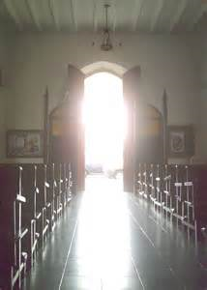
Chapter Three Overview
Opening the door is never easy, but almost always rewarding!

Slide 36
Discussion Questions: Chapter Three
Whom do you relate to in the Good Samaritan story? In what ways can you empathize with each different character in the story?

Slide 37
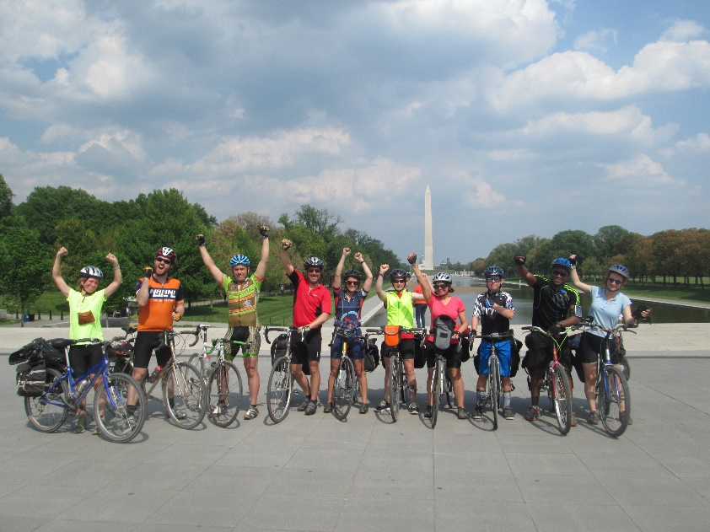
Discussion Questions: Chapter Three
Which stories in this section did you find especially inspirational?
What about them inspired you?
2015 bikers from Pennsylvania Interfaith Power & Light, including Grace Lutheran Church members Jon Brockopp, Molly Hunter, and Noah Droege, arrive in Washington, DC.

Slide 38
Discussion Questions: Chapter Three
What do you think is at stake in inter-religious work? What are the risks and possible benefits as you see them? Are there possible risks and benefits mentioned in this chapter that are new to you?

Slide 39
Discussion Questions: Chapter Three
What do you think is at stake in inter-religious work for your partners from other faiths? What risks and benefits exist for them in your view?

Slide 40
Discussion Questions: Chapter Three
How can we best foster interactions with people of other faiths that minimize the risks and increase the benefits for all concerned?

Slide 41
CHAPTER FOUR OUR GOD AND THEIR GOD: A RELATIONAL THEOLOGY OF RELIGIOUS PLURALITY

Slide 42
Chapter Four Overview
Religious differences can be seen as a threat or a source of enrichment to one’s faith.
Inter-religious dialogue is primarily between people and not between religions.
It is tempting to define others in our own theological terms, frameworks, and understandings.
We must strive to articulate a relevant and responsible theology of religious plurality faithful to our convictions and accountable to our neighbors.

Slide 43
Chapter Four Overview
The essence of a Christian view of salvation has to do with right relationship with God and our neighbors.
The Lutheran conviction that God’s activity is simultaneously hidden and revealed in creation provides a theological space for engaging with others.
Christian witness is a positive witness, not a negative, vilifying witness.

Slide 44
Chapter Four Overview
Pluralism demands that in the presence of the other we are publicly accountable for our faith and therefore invites Christian witness in dialogue with others.
Christian witness today is about practicing the reconciling work of God in the world.
Witnessing in a pluralistic society is a two-way street. Christian dialogue with people of other faiths is not a disguised monologue!

Slide 45
Chapter Four Overview
Answers to some questions cannot be resolved theologically but only discovered dialogically.
As Lutheran Christians who are called to practice hospitality, we are accustomed to being host, and we have a long way to go in learning to be guests.

Slide 46
CONCLUSION LIVING WITH THE QUESTIONS

Slide 47
Conclusion Overview
How should we engage with our non-Christian neighbors?
We are called to practice mutual hospitality.
What is a Christian view of other religions?
We can learn from revisiting scripture with new questions.
We ought to expect that we won’t have all the answers.
Dialogue is between people not religions.
We will learn about our own religion in the process.

Slide 48
Conclusion Overview
What does it mean to be a Lutheran Christian in a multi-religious world?
We celebrate God’s unmerited grace, which gives us the freedom to err on the side of generosity.
We understand faith to be a matter of trust – trust in God, trust in God’s promises – rather than knowledge.
We are heirs to the theology of the cross, which calls us to recognize the limits of human knowing.
We are heirs to a lively sense of vocation – to a calling that focuses on serving the neighbor and the community.
We accept Luther’s distinction between two kingdoms, so that we are called to be citizens who care about all people in our communities.
We have the experience of being insiders/outsiders in our rapidly changing American culture, allowing us to relate to and empathize with others.

Slide 49
Conclusion Overview
There are many reasons we should practice inter-religious dialogue and cooperation, including:
Our calling to serve our neighbor demands that we know our neighbor.
Our calling to defend our neighbor demands that we know our neighbor.
God is at work in the challenge of inter-religious relations.
Christians are called to be peacemakers.
Christian self-understanding is deepened and enhanced through engagement with others.
We are called to be good citizens, to serve the common good.

Slide 50
Discussion Questions: Conclusion
Faced with stereotypes of other religions, to what does the eighth commandment call us? What sort of response is appropriate? Note Luther’s explanation: “We are to fear and love God, so that we do not tell lies about our neighbors, betray or slander them, or destroy their reputations. Instead we are to come to their defense, speak well of them, and interpret everything they do in the best possible light” (translation by Timothy Wengert in The Book of Concord, Fortress Press, 2000).

Slide 51
Discussion Questions: Conclusion
The Conclusion emphasizes the importance of providing hospitality and receiving hospitality. What are the implications of this in your own community? What are its implications with regard to refugees and immigrants whose religion and culture may be unlike your own?

Slide 52
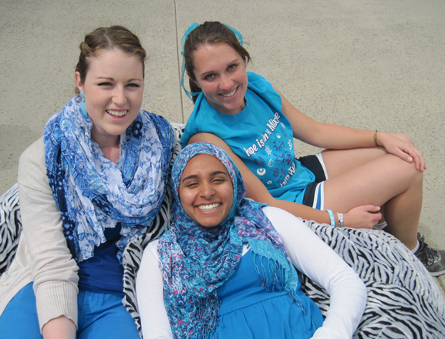
Discussion Questions: Conclusion
Do you agree that faith can and does live with unanswered questions? What difference does this make in the way a believer treats others? What are some examples from the past or from this book or from your own experience?
California Lutheran University Interfaith Allies Jamie, Shireen, and Rebecca share a moment during the IFYC’s #BeBlue #BetterTogether day in April 2013, gaining pledges for interfaith support while raising awareness for the upcoming Water Wise/Green Week campaign.

Slide 53
ADDITIONAL IDEAS & RESOURCES

Slide 54
Additional Ideas
Explore the numerous ideas and detailed approaches offered in: “Ways to Use this Book,” pp. 178-185
Invite participants to read one of the individual case studies featured in Case Studies I, II, III, or IV and to engage in discussion about:
The inter-religious calling and commitments conveyed.
The theological and practical challenges that were faced.
Whether the outcome was a “success” or “failure.”
How this example could serve as a learning or model for engagement with one’s own community/context.

Slide 55
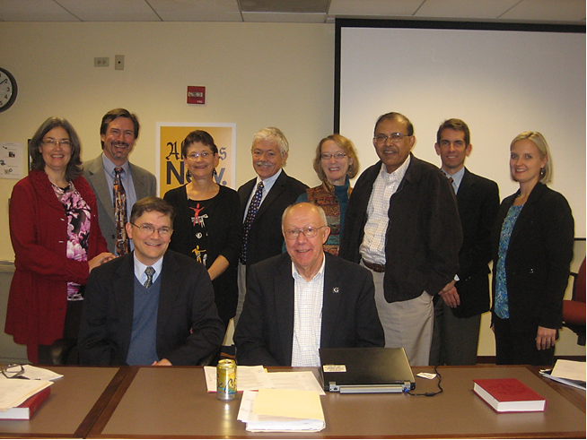
Additional Resources
See: “Helpful Websites,” pp. 190-191
Visit www.elca.org/ecumenical
Contact erinfo@elca.org
ELCA Lutheran-Jewish and Lutheran-Muslim Panel members, who began planning for this book in October 2012

